Slide 1

Project Title :– AI-Based Network Intrusion Detection System (Enterprise Edition)
Student Name - MIHIR MILIND UGHADE
AICTE ID :
Apply ID: APPLY_176424501069283e1299f48
Internship ID: INTERNSHIP_1762343729690b3b31bb89f

Slide 2

PROBLEM STATEMENT
Modern Security Operations Centers (SOCs) face high volumes of network traffic, making manual analysis impossible. Traditional rule-based firewalls often miss novel attack patterns. There is a critical need for an automated, AI-driven system to identify malicious patterns in real-time with high precision.

Slide 3
Project Description:- This project is a Network Intrusion Detection System (NIDS) built using Python and Machine Learning. It utilizes a Random Forest Classifier to distinguish between benign traffic and malicious attacks (such as DDoS or Port Scanning). The system features a real-time 'Heads-Up Display' (HUD) dashboard for visualization and a Live Packet Inspector for simulation.

Slide 4

WHO ARE THE END USERS?
Target Audience:-
Network Security Engineers
System Administrators
Security Operations Center (SOC) Analysts
Enterprise IT Managers

Slide 5

Technology Used
Language:- Python 3.8+
Machine Learning:- Scikit-Learn (Random Forest)
Dashboard UI:- Streamlit
Data Processing:- Pandas & Numpy
Visualization:- Plotly & Seaborn

Slide 6
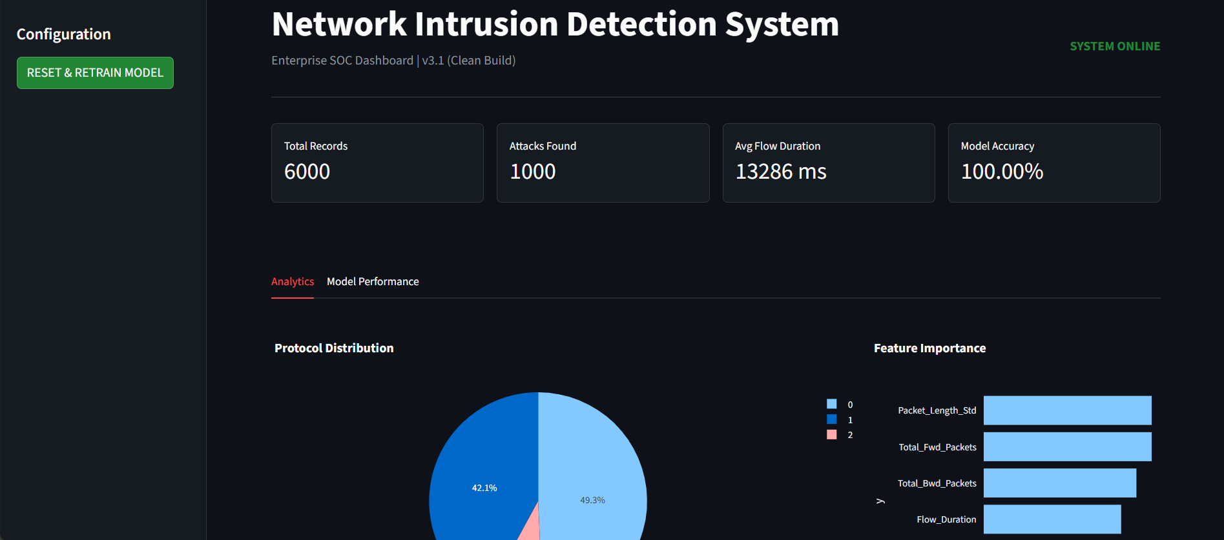
RESULTS
The "Healthy System" (Dashboard View)

Slide 7
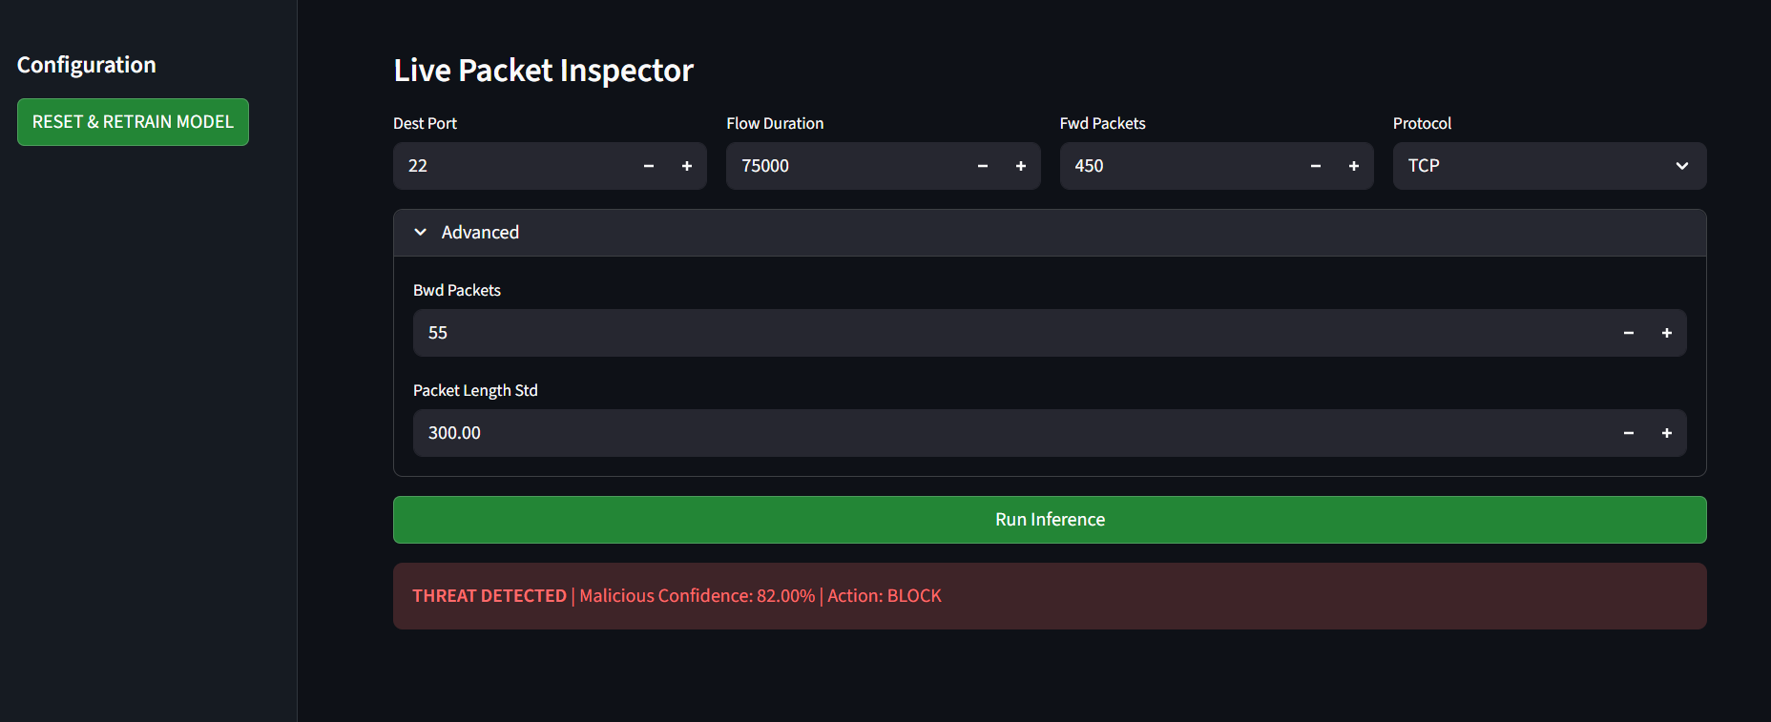
RESULTS
The "Attack Detected" (The Red Box)
Demo Link

Slide 8
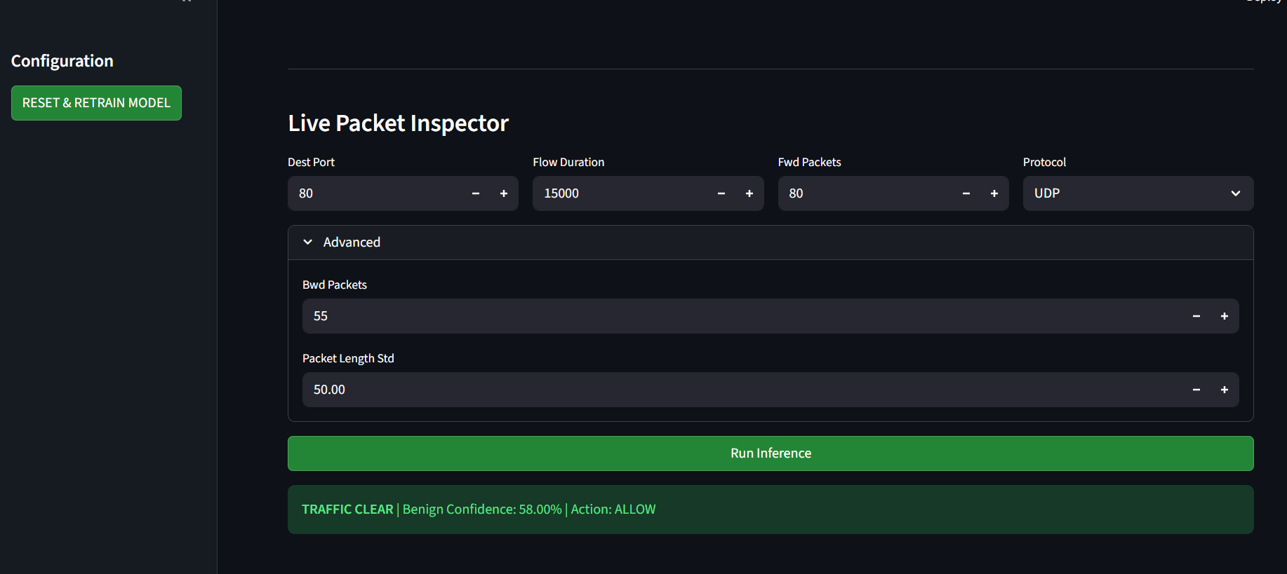
RESULTS
The "Smart AI" (The Suspicious Case)
Demo Link

Slide 9

Certificate - Protection from browser attacks

Slide 10

Certificate - Introduction to System Security

Slide 11

Certificate - Securing Android Devices

Slide 12
GitHub link:-
AI-Based Network Intrusion Detection System (NIDS)
PROJECT DASHBOARD LINK.

Slide 13
Thank you
.
.
Mihir Milind Ughade MBA (Data Science & AI) Manipal University Jaipur
📧 Email: [mihirughade0804@gmail.com]
🔗 LinkedIn: [https://www.linkedin.com/in/mihir-ughade-00601223a/]
💻 GitHub: https://github.com/mihir0804

